Slide 1
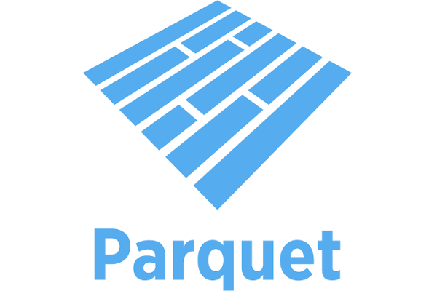
Parquet Files
https://www.databricks.com/blog/what-is-parquet

Slide 2
What is Parquet?
Apache Parquet is an open source, column-oriented data file format designed for efficient data storage and retrieval. It provides efficient data compression and encoding schemes with enhanced performance to handle complex data in bulk. Apache Parquet is designed to be a common interchange format for both batch and interactive workloads. It is similar to other columnar-storage file formats available in Hadoop, namely RCFile and ORC.
https://www.databricks.com/blog/what-is-parquet

Slide 3
What are the characteristics of Parquet?
Free and open source file format.
Language agnostic.
Column-based format - files are organized by column, rather than by row, which saves storage space and speeds up analytics queries.
Used for analytics (OLAP) use cases, typically in conjunction with traditional OLTP databases.
Highly efficient data compression and decompression.
Supports complex data types and advanced nested data structures.
https://www.databricks.com/blog/what-is-parquet

Slide 4
What is the difference between Parquet and CSV?
Amazon Athena and Spectrum will charge based on the amount of data scanned per query.
Google and Amazon will charge you according to the amount of data stored on GS/S3.
Google Dataproc charges are time-based.
Parquet has helped its users reduce storage requirements by at least one-third on large datasets, in addition, it greatly improved scan and deserialization time, hence the overall costs. The following table compares the savings as well as the speedup obtained by converting data into Parquet from CSV.
https://www.databricks.com/blog/what-is-parquet

Slide 5
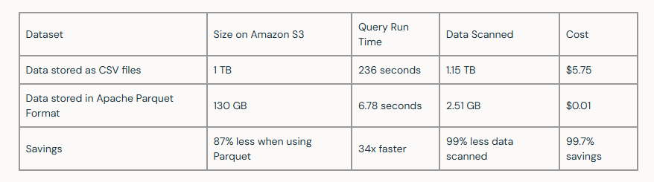
What is the difference between Parquet and CSV?
https://www.databricks.com/blog/what-is-parquet

Slide 6
What is Parquet?
Apache Parquet is an open source, column-oriented data file format designed for efficient data storage and retrieval. It provides efficient data compression and encoding schemes with enhanced performance to handle complex data in bulk. Apache Parquet is designed to be a common interchange format for both batch and interactive workloads. It is similar to other columnar-storage file formats available in Hadoop, namely RCFile and ORC.
https://www.databricks.com/blog/what-is-parquet

Slide 7
Creating parquet file
import duckdb
duckdb.sql("""
COPY (
SELECT *
FROM read_csv_auto('input.csv')
)
TO 'output.parquet'
(FORMAT PARQUET);
""")

Slide 8

DuckDB is an open-source column-oriented relational database management system. It is designed to provide high performance on complex queries against large databases in embedded configuration, such as combining tables with hundreds of columns and billions of rows.

Slide 9
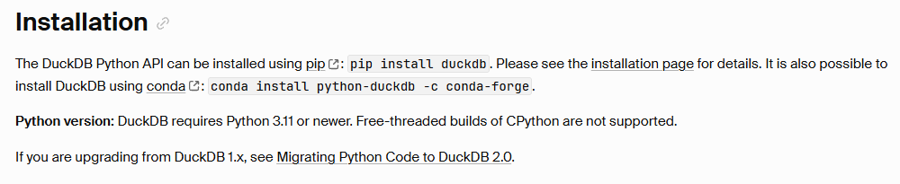
https://duckdb.org/docs/2.0/clients/python/overview

Slide 10
Basic API Usage
The most straight-forward manner of running SQL queries using DuckDB is using the duckdb.sql command.
import duckdb
duckdb.sql("SELECT 42").show()
This runs the query on an in-memory database that is stored globally inside the Python module. The first call that needs this database creates it.
duckdb.sql() returns a relation: an object you can query further or convert to Python data. A query that only reads data runs when you fetch or display its result. Reading it again runs the query again. Use duckdb.execute() for statements such as CREATE TABLE and INSERT.
https://duckdb.org/docs/2.0/clients/python/overview

Slide 11
Data Input
DuckDB can ingest data from a wide variety of formats – both on-disk and in-memory.
import duckdb
duckdb.read_csv("example.csv") # read a CSV file into a Relation
duckdb.read_parquet("example.parquet") # read a Parquet file into a Relation
duckdb.read_json("example.json") # read a JSON file into a Relation
duckdb.sql("SELECT * FROM 'example.csv'") # directly query a CSV file
duckdb.sql("SELECT * FROM 'example.parquet'") # directly query a Parquet file
duckdb.sql("SELECT * FROM 'example.json'") # directly query a JSON file
https://duckdb.org/docs/2.0/clients/python/overview

Slide 12
Save your database permanently
So far, duckdb.connect() creates an in-memory database. When you close it, the database's contents are not saved to disk.
import duckdb
con = duckdb.connect("my_sales.duckdb")
con.execute("""
CREATE TABLE IF NOT EXISTS sales (
product VARCHAR,
quantity INTEGER,
price DECIMAL(10, 2)
)
""")
con.execute("""
INSERT INTO sales VALUES ('Monitor', 2, 150.00)
""")
con.close()
https://duckdb.org/docs/2.0/clients/python/overview

Slide 13
reopen the same database:
con = duckdb.connect("my_sales.duckdb")
con.sql("SELECT * FROM sales").show()
https://duckdb.org/docs/2.0/clients/python/overview

